Slide 1
Saint Venant Equations
Surface Waves

Slide 2
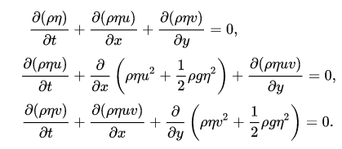

Governing Equations
ρ: density; η: wave height; u: x-velocity;
v: y-velocity; g: gravity
https://en.wikipedia.org/wiki/Shallow_water_equations

Slide 3
Objective
Using MPI, create a parallel solver for the set St. Venant equations
Derived from the Navier-Stokes equations
Beautiful visualizations
Comparison of run times with and with out parallelizations

Slide 4
Strategy
Kathy
Equation implementation
Together
Parallelizing
Andrew
Data visualization

